Slide 1
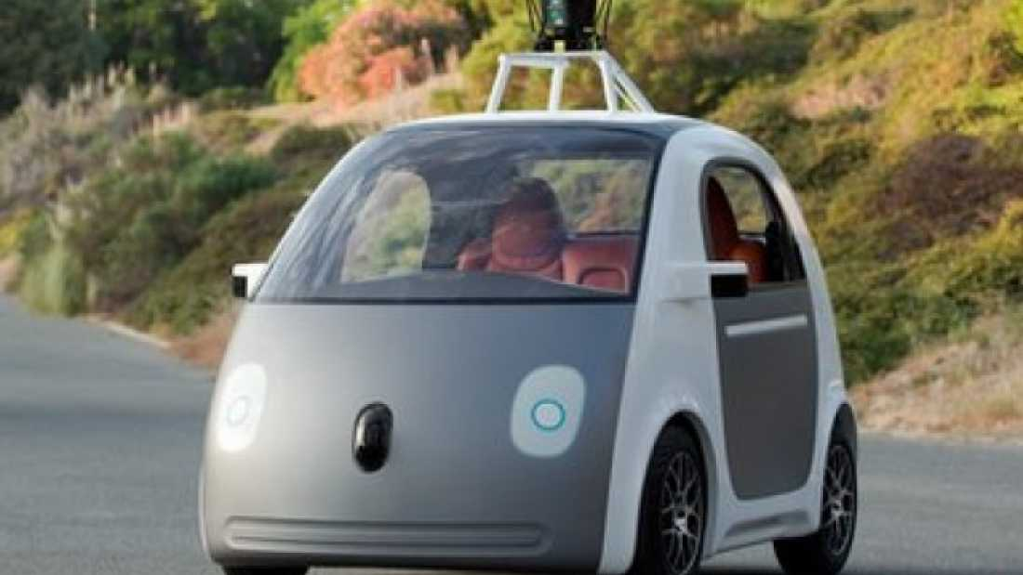
Lab | Machine Learning and AI world: Google Autonomous Car
René van Schalkwyk • 04.10.2021

Slide 2
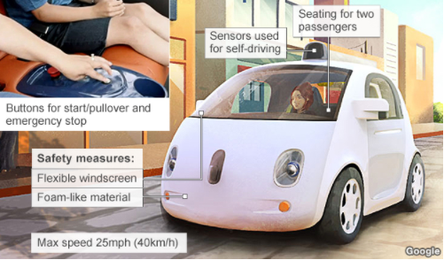
Overview
2.24 million injuries due to motor vehicle accidents in the United States in 2010; mainly due to human error.
Google is hoping to make the streets a bit safer by developing a self-driving car.
Looks very similar to two-passenger subcompact “smart cars” currently on the market.
No steering wheel or pedals to accelerate/decelerate.
Passenger presses a button to start the car, and then inputs the destination into the car’s computer that utilizes Google Maps.
Currently max speed at 40 km/h (25 mph) as a safety measure.
Emergency break available, to be used if necessary.

Slide 3
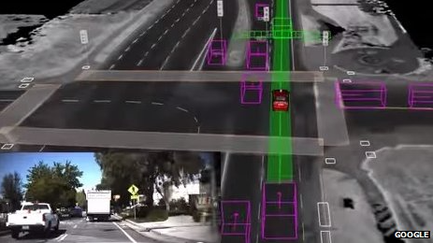
How does it work?
On top of the car, a sensor spins around that actively monitors surroundings in all directions over 180 meters (0.1 mile) away.
The car’s computer gains information through both laser and radar sensors, as well as camera data.
According to an estimate, a Google car produces around 1GB of sensor data per second; 2 million GB of data per year per car; assuming average driving of 600 hours per year
Currently the servers needed to process this data are in the car’s trunk and require their own large cooling system.

Slide 4
What data is being used?
Technical data (inside-out)
how the car learns about avoiding obstacles;
data comes from the car’s sensors and is analyzed by machine learning algorithms
Community data (outside-in)
crowd-sourced data about traffic and driving conditions from Waze-like platforms
Personal data
riders’ personal preferences serving to improve the user experience.

Slide 5
What models are being used?
Learning algorithms are implemented to improve the driving ability;
a car can identify differences between objects (water bottle vs. rolled newspaper) to incorporate that learning in future situations;
identify certain actions by observing behavior over and over again (e.g. when pedestrian is ready to cross a road).
Algorithms also need to sort through what is important;
predictive as well as prescriptive models are used to improve the ability to recognize and react to surroundings.
Prebuilt navigation maps indicate static infrastructure;
enables software to quickly identify moving objects, like pedestrians and cyclists;
enables algorithms to process the traffic situation and plot a path safely through it.

Slide 6
Advantages and concerns
Advantages
Could potentially make roads safer;
Could be beneficial to those who cannot drive regular cars due to advanced age, vision impairments, or certain medical conditions;
Depending on outcome with regulations, it could also be used by persons under the age of 16.
Concerns
It may threaten the jobs of those who drive taxis/buses/limousines;
Could increase suburban sprawl;
Legal aspects;
accidents do happen;
Security and personal data issues;
hackers who could take control over the car;
cars will expose personal location data.

Slide 7
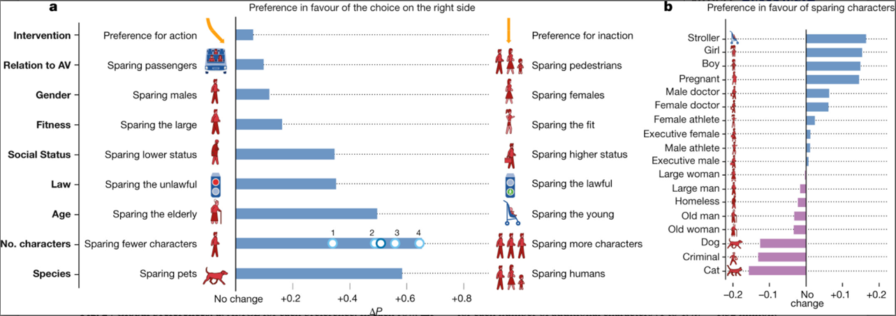
“The Moral Machine experiment”
Notes:
In November 2018, Nature magazine published an article on ‘The Moral Machine experiment’. Based on a survey developed by MIT researchers (in the form of a multilingual online game) that reveal global preferences concerning the ethics of autonomous vehicles, as well as some regional variations in those preferences. This platform gathered 40 million decisions in ten languages from millions of people in 233 countries and territories. In these figures, the global moral preferences are summarized.
As shown in Fig.2a, the strongest preferences are observed for sparing humans over animals, sparing more lives, and sparing young lives.
Fig.2b: the four most spared characters are the baby, the little girl, the little boy, and the pregnant woman

